Slide 1

Team: Supervisor:
Mir Saad Ali (19K-0133) Mr Basit Ali
Muhammad Maaz (19K-0148) Co-Supervisor:
Ammar Ullah Khan (19K-1435) Syed Zain ul Hassan

Slide 2
Project Overview
The proposed solution aims to create a comprehensive community support platform that addresses the current lack of a centralized app for community work. Existing apps are limited in functionality and do not offer a comprehensive solution. The platform will provide key functionalities such as ambulance services, blood donations, and missing persons, and empower individuals to support each other in times of need.

Slide 3

Progress
Milestone 1 (Workflow-System)
Half of screens have been designed and build
Api’s for this component have been coded
Milestone 2 (Api-Development)
Api’s for the next milestone have been developed

Slide 4
Glimpse of Api’s Developed so far
Users Api
Sign Up
Log in
OTP Verification
Change Password
Posts Api
Get All Posts
Get Post By ID
Get All Pending Posts
Get All Approved Posts
Get Post By User Email
Get Blood Request Count
Get Urgent Post
Admin Api
Delete User
Update User Details
Display All user
Get all team
Feature Api
Create New Feature
Delete feature by ID
Delete feature by title
Edit title by feature id
Edit title by title
Edit description by feature id
Edit description by title
Add new field in feature
Delete field by title
Get Feature by title
Get all features

Slide 5
Progress
Milestone 3 (Admin Panel)
1. Users’ details display
2. Team detail display
3. Pie graph to show category wise request distribution
4. Bar graph to track area wise request
5. Line graph to track the trajectory of requests
6. Category wise number of requests
7. Pending Requests

Slide 6

Risk and Challenges
Server deployment on cloud platform.
Cv work needs greater CPU and GPU.
Cross platform integration Python and Nodejs.
Api’s integration for cross origin request.

Slide 7
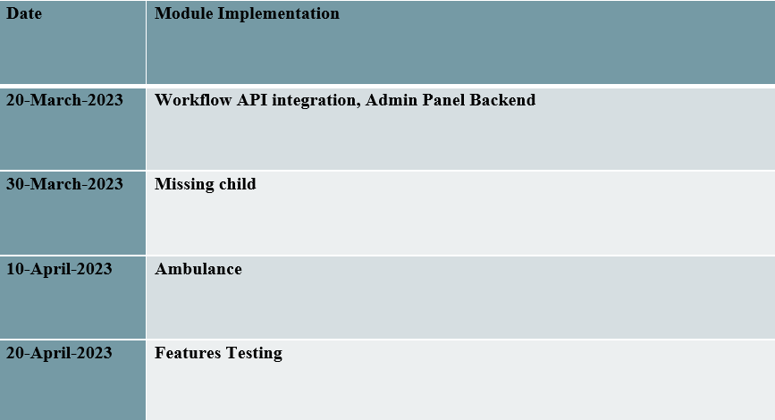
Updated Timeline

Slide 8
Thank you for your time 😊

